Slide 1
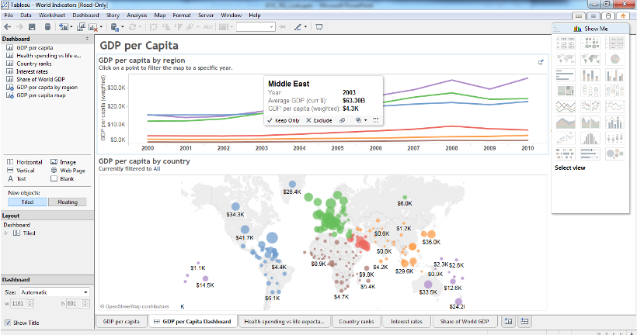
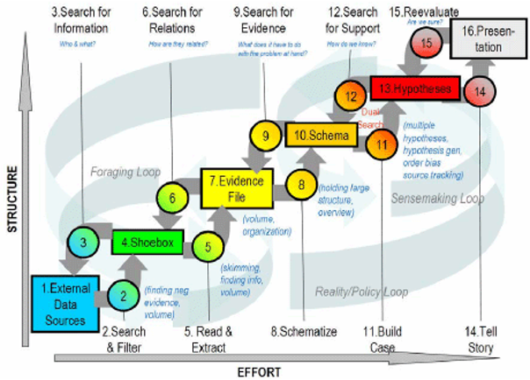
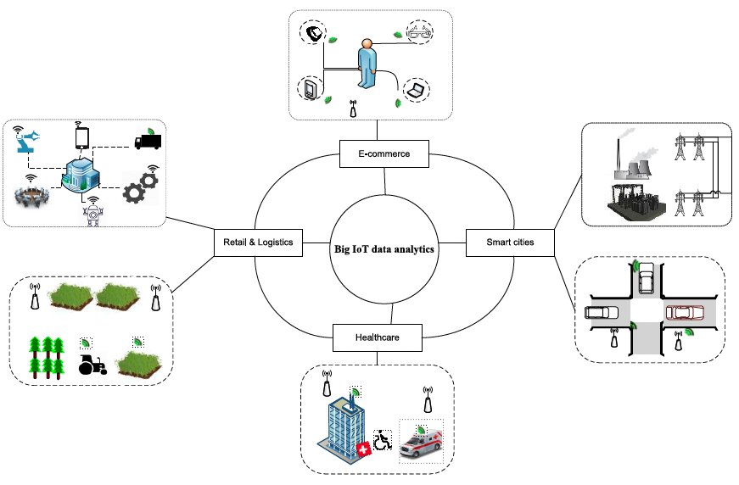
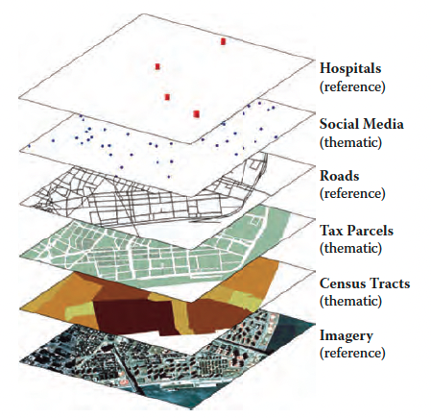

Course Overview and Briefly Literature Resources
ISTE-782
VISUAL ANALYTICS
By Dr.Bilgic

Slide 2
“... Instead of treating increased adoption of data-driven storytelling as an unqualified good, … data visualizations are not simply tools that people use to understand the epidemiological events around them. They are a battleground ...”
(Lee et al., 2021, Viral Visualizations …)

Slide 3

Who am I?
PhD focused in Computational and Nonparametric Statistics from Western Michigan University, 2012
Statistical Modeling, Machine Learning, Data Science, and Data Analysis/Analytics
Teacher, Instructor, Entrepreneur and Consultant with a history of working in the higher education industry and professional world
Research, Capstone, Projects, Startups etc
Dr. Yusuf Bilgic, ykbics@rit.edu
Office Location: GOL-2675
Office Hours (all can join):
Tue (in person or online office hours) - 3:00pm-4:50pm
Thursday (online office hours) - 3:00pm-4:50pm
Or, by appointment
Office Hours Zoom Link: https://rit.zoom.us/j/6250353278 (passcode: hi)

Slide 4
Topics and Tools to Learn in the Course

Slide 5
What Topics and Tools Covered in the Course?
Theory and Method:
Components of data visualization, graphics, graphical excellence, pitfalls
Cognitive and perception elements of data visualization, interaction, information visualization
Design principles, visual limitations
Contemporary approaches and trends
Time, space, location, GIS
Text Analytics and Social Media Data
IoT, Big Data Viz and Contemporary Tools
AI Explainable, Debates
… in the form of graduate seminars.
Tools and Techniques:
Tableau + Python Integration
Python
Plotly
Dash Plotly
qGIS or Equivalent
R+RShiny+Interactives
Web-based tools
More
… in demo and collaboration format.

Slide 6
Briefly Reading Resources

Slide 7
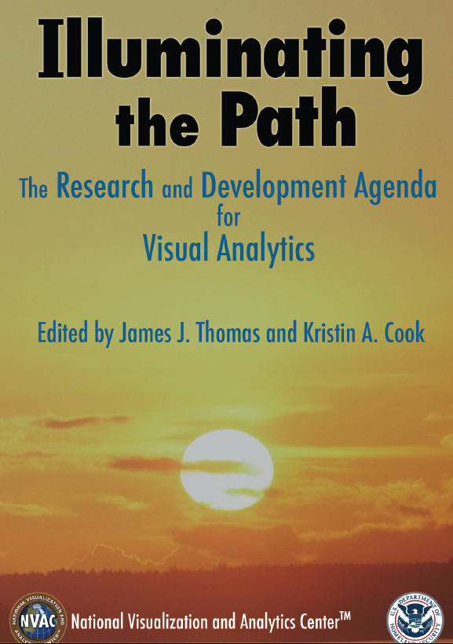
Thomas and Cook (2005): The Research and Development Agenda for Visual Analytics
The US Department of Homeland Security (DHS) chartered the National Visualization
and Analytics Center (NVAC) in 2004 with the goal of helping to counter future terrorist attacks
Individuals selected in 2004 as the best and brightest multidisciplinary team to define the research and development agenda for the future directions: representatives from industry, academia, government, and national laboratories
The mission of DHS is to: “...lead the unified national effort to secure America.”

Slide 8
Thomas and Cook (2005)
“One challenge underlies all of these objectives: the analysis of overwhelming amounts of disparate, conflicting, and dynamic information to identify and prevent …” (p.2)
Visual Analytics (VA) is a response to the challenges.
This agenda presents recommendations to advance the state of the art in the major visual analytics research areas:
The science of analytical reasoning
Visual representations and interaction techniques
Data representations and transformations
Production, presentation, and dissemination.
New terms and definitions:
The Science of Analytical Reasoning
Visual analytics and the goal of visual analytics
VA is the science of analytical reasoning facilitated by interactive visual interfaces. (p.4)

Slide 9
Keim et al. (2010): Mastering the Information Age - Solving Problems with Visual Analytics
Working groups joined in 2008-2010 in EU, research excellence in the fields of data management, data analysis, spatial-temporal data, and human visual perception research with the wider visualization research community
Reviewed all aspects of visual analytics, indicating open areas and strategies for the research in the coming years
Visual analytics is not easy to define: “Visual analytics combines automated analysis with interactive visualizations analysis techniques with interactive visualizations for an effective understanding, reasoning and decision making on the basis of very large and complex datasets”. (read pg.7)
Comparison of this definition with the previous one: added components and considerations

Slide 10
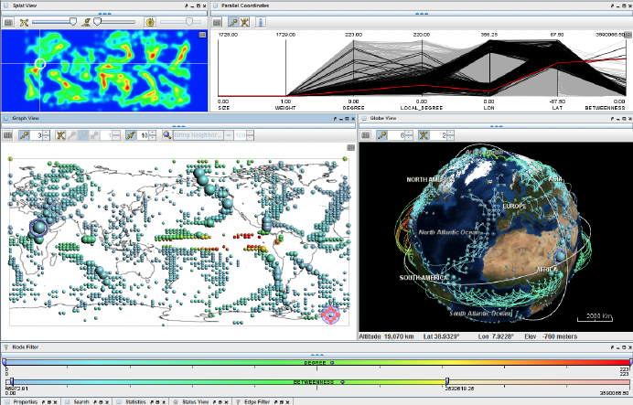
Theory and Rules of Graphics
Tufte (2001): The Visual Display of Quantitative Information
Graphical practice, excellence
Theory of data graphics
Minard’s chart (pg.40-41)
Bertin (2011), Ch1, pg.2-40: Semiology of Graphics
Jacques Bertin’s landmark book presents a theory of what we now call data visualization but which Bertin referred to as graphics.
His theory is a “sign-system” of graphics. Semiology is the study of sign-systems.
Analysis of the information: The invariant and the components
Definition of graphics and general theory
The rules of the graphic system and the construction and reading of efficient graphics
Wilkinson (2005): Grammar of Graphics
Excellent book of grammatical rules for creating perceivable graphs, or what we call graphics
Terms defined: What is the difference between graphics and charts?
Wickham (2010): Layered Grammar of Graphics is the theory behind ggplot2 in R

Slide 11
Cognitive, Interaction, Processes
Pike and Stasko (2009): The science of Interaction
Interaction in VA: reasoning components, terms, challenges
“The goal of a science of interaction is to support the visual analytics and human–computer interaction communities through the recognition and implementation of best practices in the representation and manipulation of visual displays”.
Principles of design and perception
Ware (2013), Ch11: Visual Thinking Processes
Cognitive system behind visualization
Visual attention scheme
Pirolli and Card (2005): The Sensemaking Process and Leverage Points for Analyst Technology as Identified Through Cognitive Task Analysis
Notional model of sensemaking loop for intelligence analysis
Cognitive task analysis
Intelligence analysis as sensemaking
Norman (2013): The Design of Everyday Things
How people do
The Psychology of Everyday Actions
The Seven Stages of Action and the Three Levels of Processing

Slide 12
More on VA: Spatio-temporal, GIS, NLP, Big Data, IoT
Andrienko (2010): Space, time and visual analytics
Approaches to space and time in visual analytics
Everything is spatio-temporal: nice examples
Tomaszewski (2015): Geographic Information Systems
Components of GIS
The layering of geographic information
Lauriola (2022): An introduction to Deep Learning in Natural Language Processing: Models, techniques, and tools
Survey of the application of deep learning techniques in NLP
Main resources in NLP research
Birjali (2021): A comprehensive survey on sentiment analysis: Approaches, challenges and trends
Sentiment analysis approaches, challenges, and trends
Marjani (2017): Big IoT Data Analytics
Proposing a new architecture for big IoT data analytics
Relationship between IoT and big data analytics
Explainable AI, Contemporary Topics, Debates
Some reading articles to be covered

Slide 13
Minard’s Graph: What does this map tell us?

Slide 14
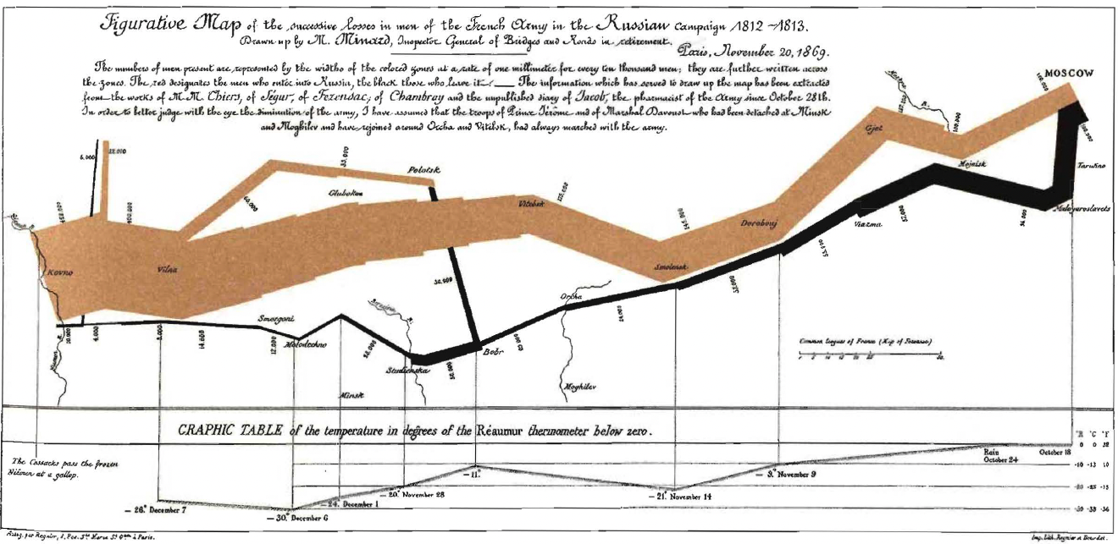
Notes:
Original map in French

Slide 15
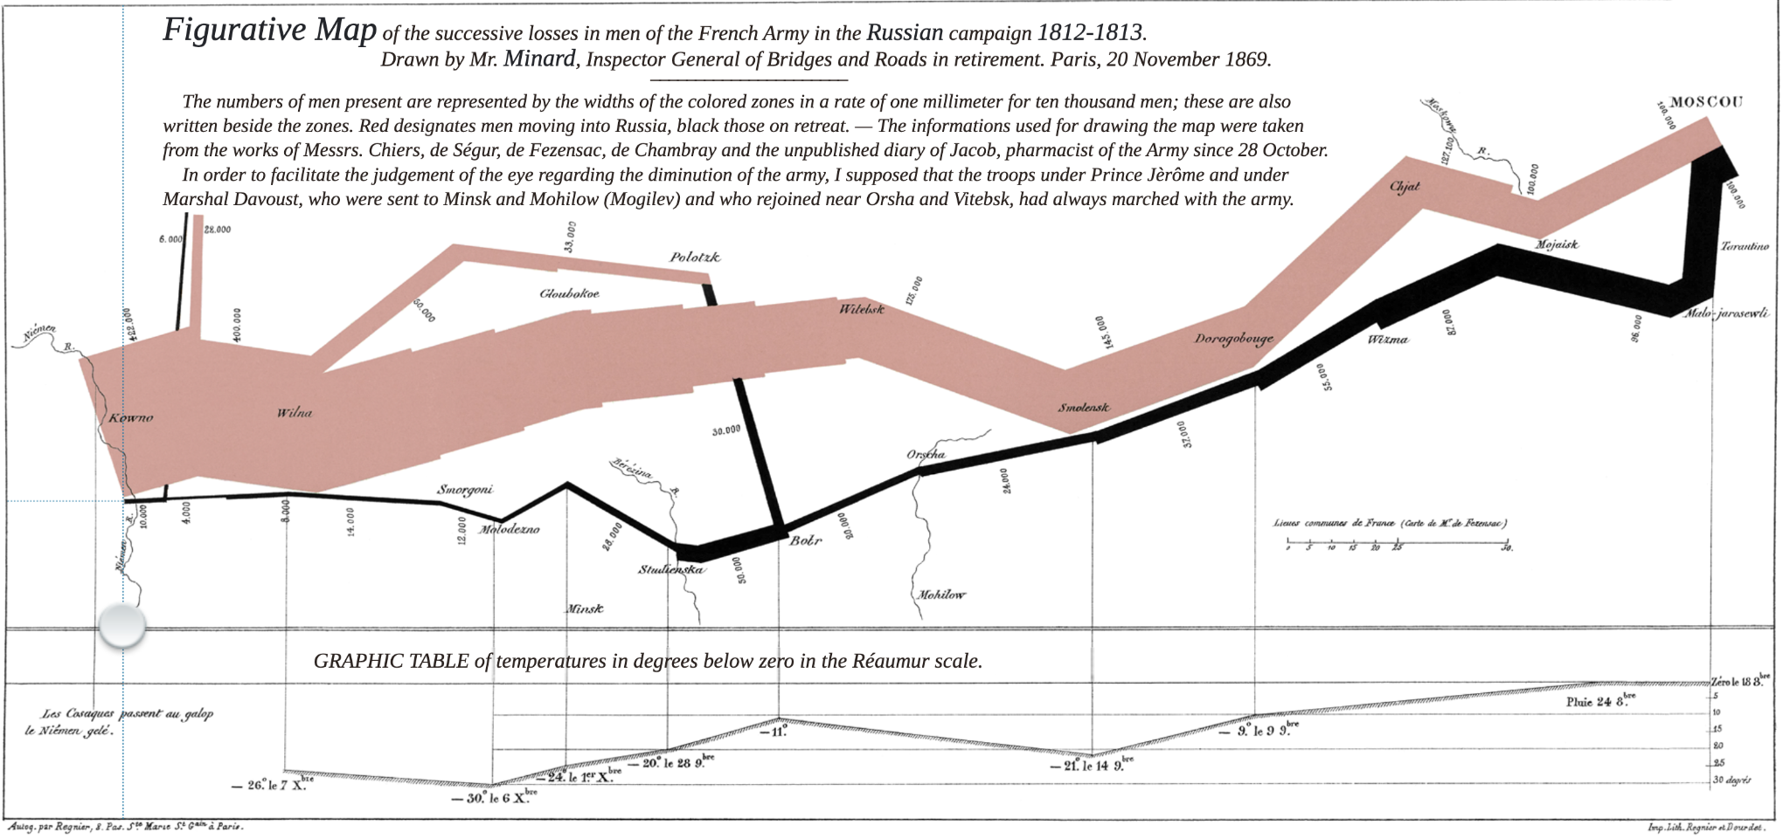
https://www.masswerk.at/minard/
Notes:
https://www.masswerk.at/minard/
The graphic is the combination of data map and time-series, drawn in 1869, portrays a sequence of devastating losses suffered in Napoleon's Russian campaign of 1812.
Flow-line shows the size of the Grand Army as it invaded Russia in June 1812.
Minard's graphic tells a rich, coherent story with its multivariate data with at least six variables: the size of the army, its location
on a two-dimensional surface, direction of the army's movement, and temperature on various dates. The seventh is …
“The map that made a nation cry”: Depicting the Grande Armée’s great disaster by geography, time, and temperature, Minard’s famous map from 1869 is one of the earliest examples of a flow map.
Out of 422,000 men, crossing the Niemen in 1812 on their way to Moscow, only 10,000 returned alive to see the Niemen again. Drag the knob over the chart to explore their return march from Moscow.
It shows the terrible fate of Napoleon's army in Russia.

Slide 16
How many variables are shown in the Minard’s graphic/chart/map?
Take a moment and count how many variables are shown.
Did you get the seven variables?
Feel free to start a discussion on the Discussions post (or in the class) if anyone got seven variables.
Also, what story does this map tell us about the life/history/politics/anthropology? Any lesson learned? (address the descriptive, predictive, prescriptive aspects of data analytics)
Your answers:

